Slide 1
Find My Protest
A platform that displays
historical & future
protest data for Berlin.
Allowing Users to find events based on
categories & their own search criteria
+
it will predict the crowd size of upcoming protests.
TechLabs 2024

Slide 2

Data Science and Deep Learning
Our Data
Process of deciding for Data:
Shrinking Data from Worldwide to Berlin
Berlin
Versammlungsbehörde(State)
&
Newspaper
Newspaper (Riots + Protests)
Categories:
Date, City Districts,
Event Type, Interactions + Actors,
Crowd Size, Notes
DL is adding Topic & Category, (Organisation), …
Data is coming from newspaper
https://docs.google.com/spreadsheets/d/1nj3jeYxOHhshLIZ3mbw4kQncFdy3UgL43krZ7qkPrLk/edit#gid=446564360

Slide 3
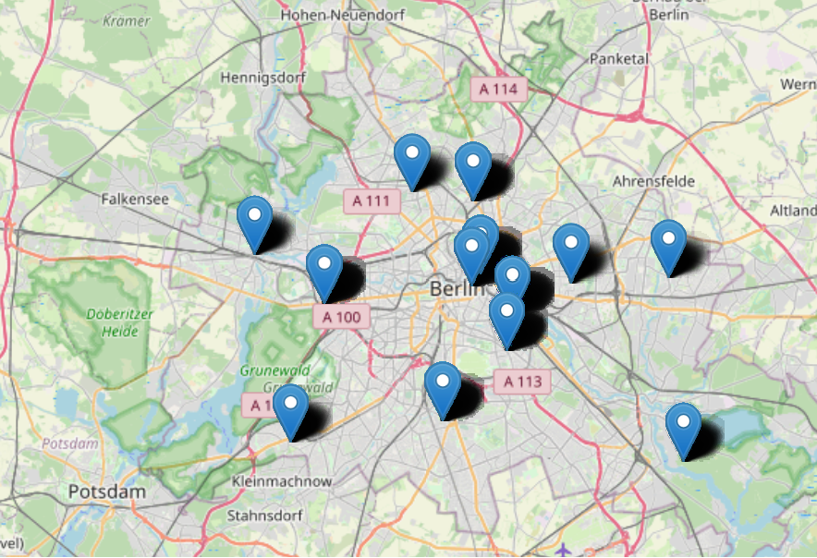
Where did the protests take place?
Berlin Protests happened in 13 different areas

Slide 4
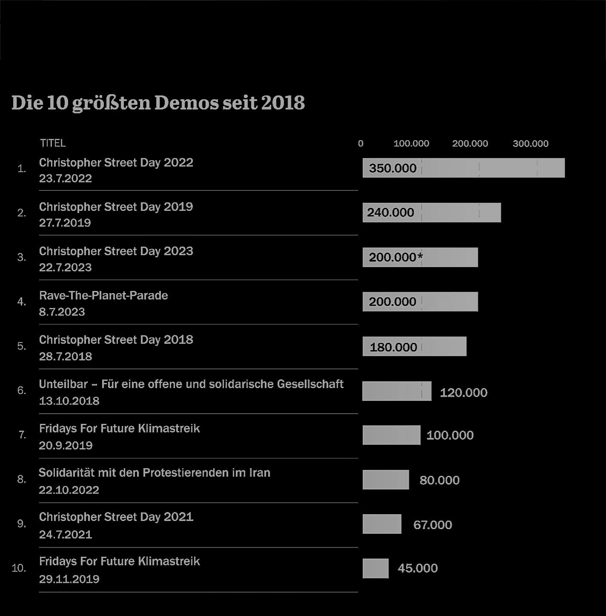
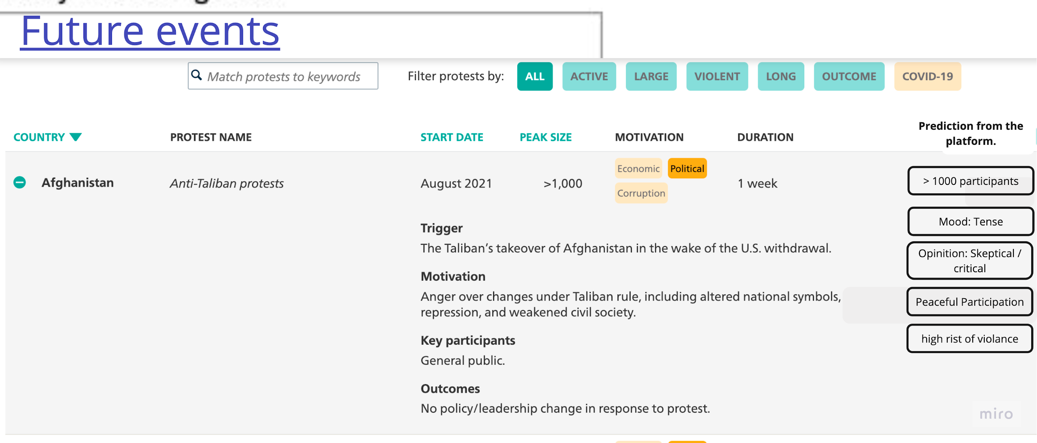
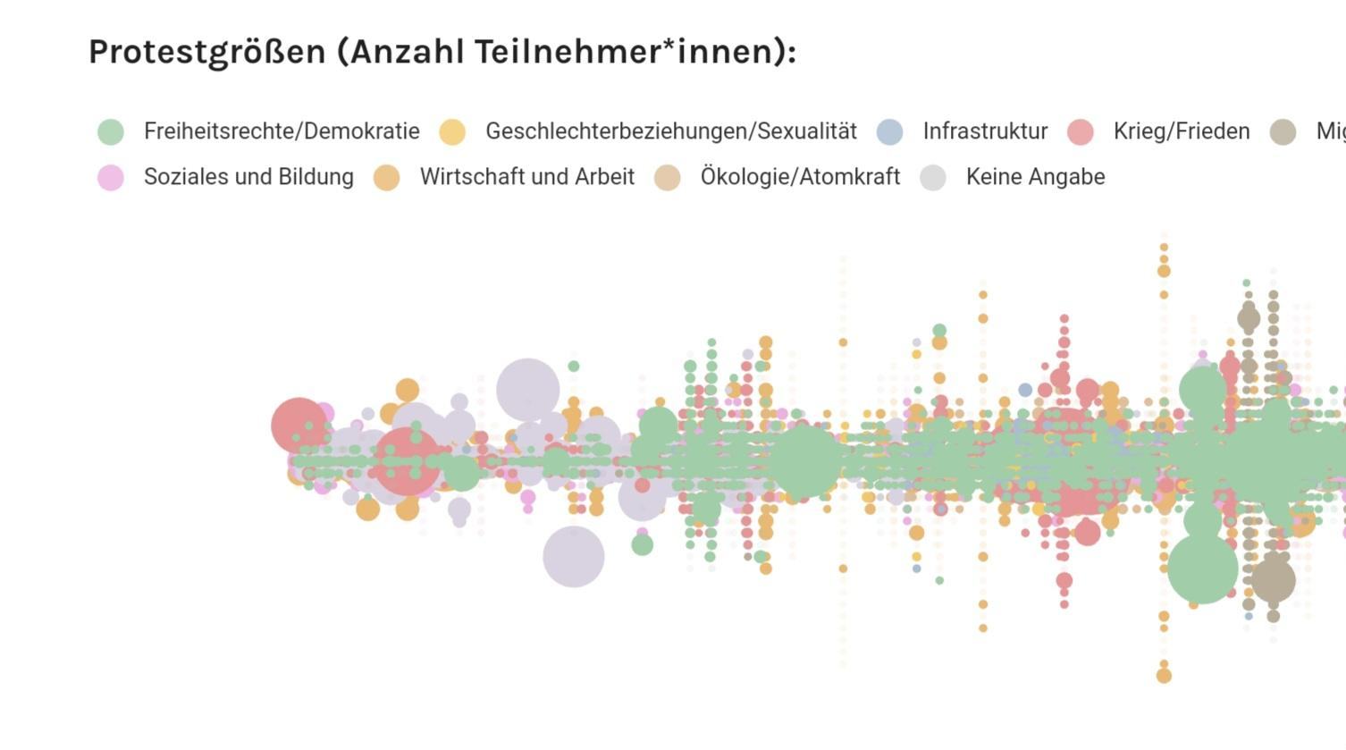
DS: Analysation & Regression
Analysing the Protest
<< << &
predicting the crowd size,
with the help of Regression
>> >>
Inspo from https://carnegieendowment.org/publications/interactive/protest-tracker#
Inspo from https://interaktiv.tagesspiegel.de/lab/demo-atlas-berlin-wofuer-wird-in-meiner-nachbarschaft-demonstriert/

Slide 5
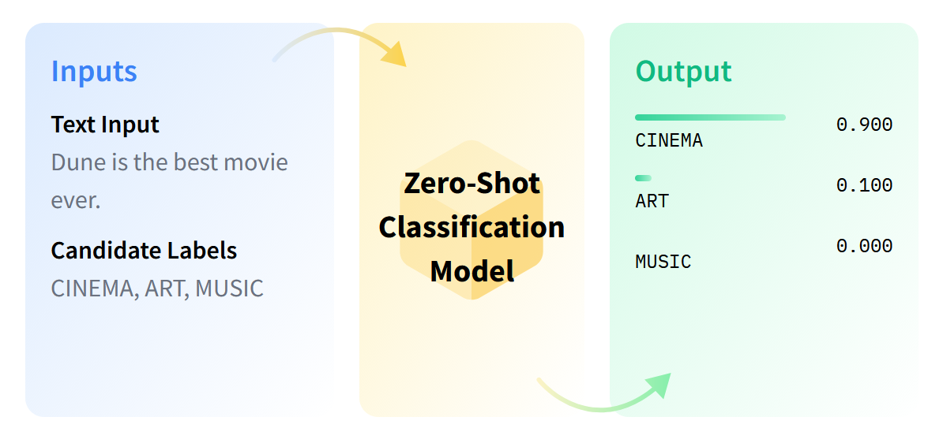
DL: Zero-Shot Classification
Zero-shot text classification is a task in natural language processing where a model is trained on a set of labeled examples but is then able to classify new examples from previously unseen classes.

Slide 6
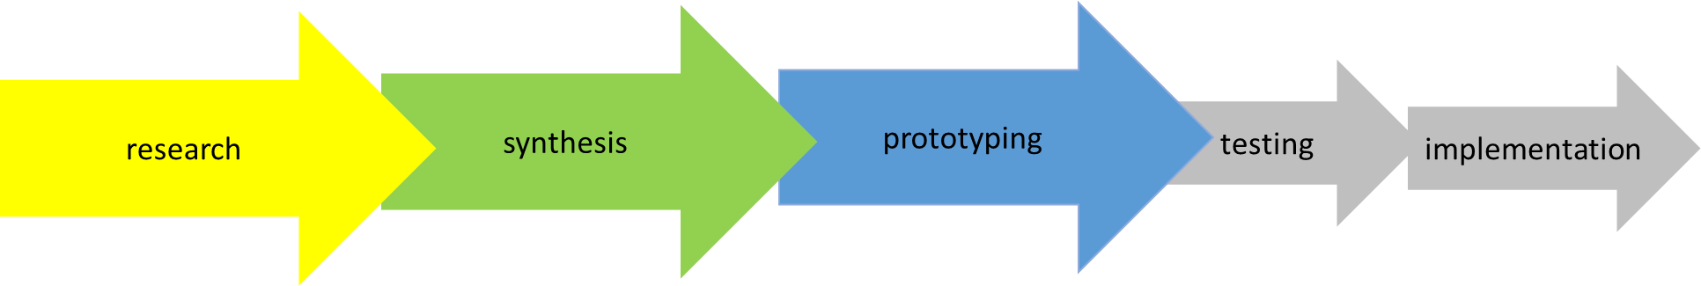
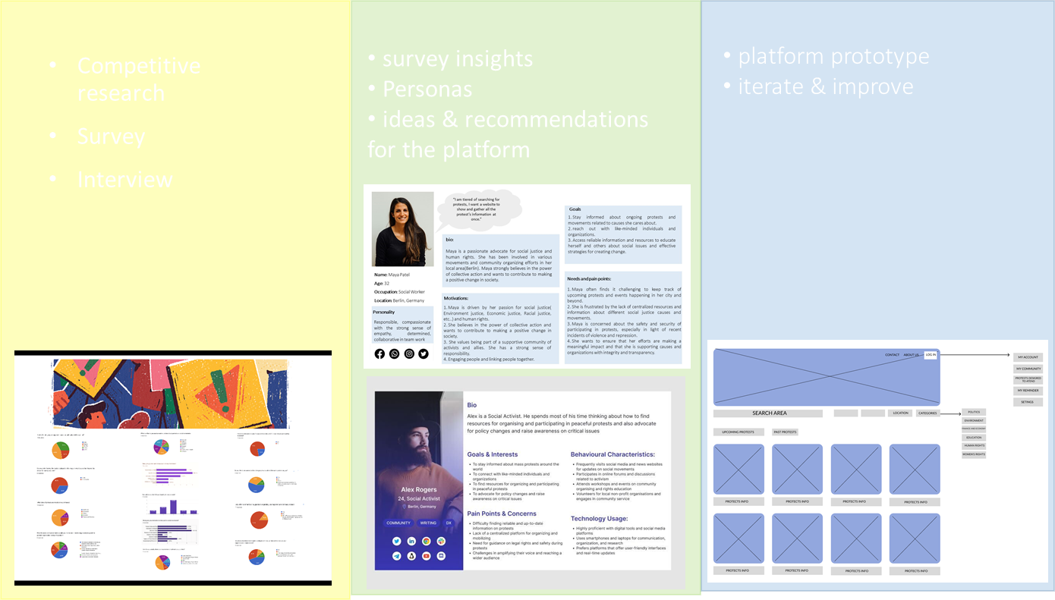
Phases:
UX

Slide 7
WebDev
Major challenges so far:
- Understanding frontend and backend role
- First approach was to re-render static templates
- then decided that React client component will be connected through a server API from backend and be requested in a Router page by frontend
Major win so far:
- Being able to successfully test a connection between client and server
- finding a first approach to translate wireframes from UX Team and plan how to implement the desired components
What features do you find most useful?

